Slide 1

Salvo grima Case study

Slide 2
Overview
In this presentation, I have outlined a solution for improving the data collection and reporting function for Salvo Grima using the technology stack tools provided. The solution involves setting up a flow in Power Automate to extract financial data from emails, inserting the data into the ERP system using MS SQL, creating a custom app in Power Apps for inputting the data, integrating the app with Power Automate to validate the data, using Power BI to create reports and dashboards, and using Office 365 to manage and share the reports. By implementing this solution, you can significantly improve the efficiency and accuracy of the financial management process for the companies.
In the following slides a more detailed explanation of the hypothetical workflow implementation

Slide 3
Introduction
The current process for collecting and reporting financial data for the companies involves receiving emails with the data and manually entering it into the ERP system
This process is time-consuming and prone to errors, as there is no automated way to check the data for accuracy and completeness
The finance team must reconcile the data on a monthly basis to ensure there are no incorrect entries, which adds to the workload
There is need to improve the efficiency and accuracy of the process in order to reduce the workload and minimize the risk of errors
The proposed solution is to automate the data collection and reporting function using the tools in the technology stack (Power Automate, Power Apps, Power BI, and Office 365)

Slide 4
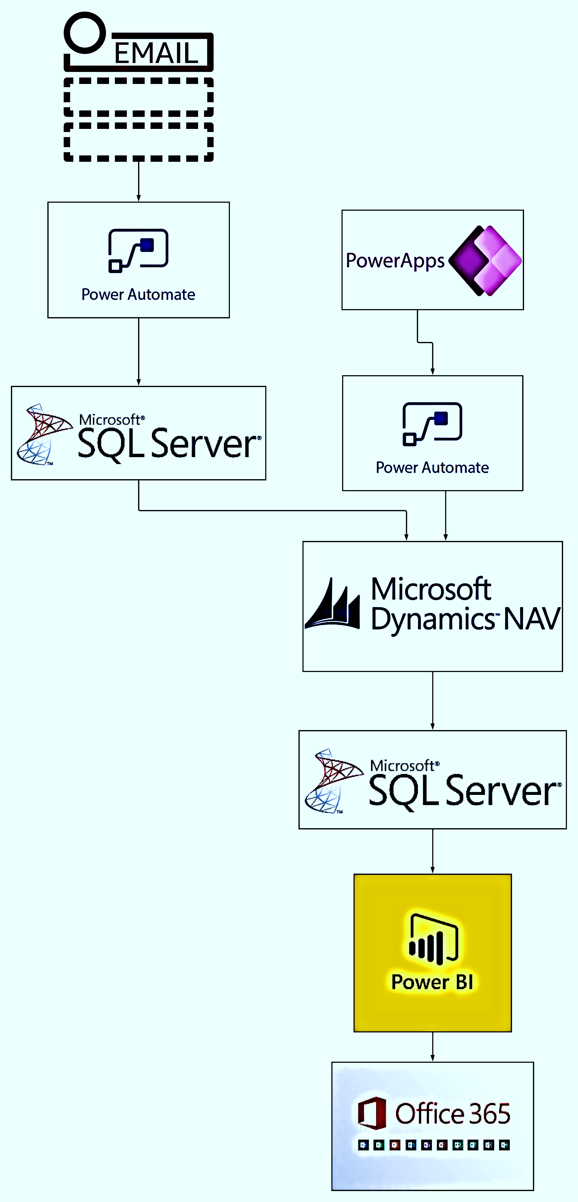
introduction
In this workflow:
Power Automate is used to trigger a flow when an email is received from one of the companies and to extract the relevant data from the email.
MS SQL is used as the on-premises database server to insert the data into the ERP system.
Power Apps is used to create a custom app for inputting the data directly into the ERP.
Power Automate is used to validate the data before it is entered into the ERP.
Power BI is used to create reports and dashboards
Office 365 is used to manage and share the reports and dashboards with the finance team.

Slide 5
Solution overview
The proposed solution is to automate the data collection and reporting function using the tools in the technology stack (Power Automate, Power Apps, Power BI, and Office 365)
The solution will involve the following steps:
Setting up a flow in Power Automate that triggers when an email is received from one of the companies with financial data
Extracting the relevant data from the email using connectors
Inserting the data into the ERP system using MS SQL as the on-premises database server
Creating a custom app in Power Apps that allows the associate to input the financial data directly into the ERP system
Integrating the app with Power Automate to trigger a flow that checks the data for accuracy and completeness before it is entered into the ERP
Using Power BI to create reports and dashboards that provide real-time insights into the financial performance of the companies
Using Office 365 to manage and share the reports and dashboards with the finance team
Overall, this solution involves using the tools in the technology stack to automate the data collection and reporting function for the companies. By automating the process, you can significantly improve the efficiency and accuracy of the financial management process for the companies.

Slide 6
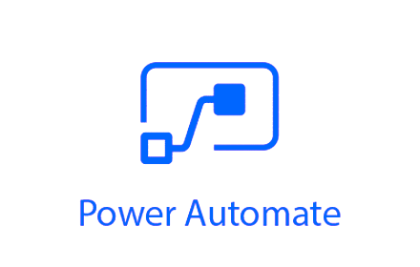
Set up a flow in Power Automate
In this step, we will use Power Automate to set up a flow that triggers when an email is received from one of the companies with financial data
The flow will use connectors to interact with the email system and extract the relevant data from the email
To set up the flow, we will need to:
Connect Power Automate to the email system using the appropriate connector
Set up a trigger that listens for new emails from the companies with financial data
Use the email connector to extract the relevant data from the email
Store the extracted data in variables that can be used later in the flow
Overall, this step involves using Power Automate to extract the financial data from the emails and store it in a format that can be used later in the flow. By automating this process, we can reduce the workload and minimize the risk of errors.

Slide 7


Insert the data into the ERP using MS SQL
In this step, we will use MS SQL as the on-premises database server to insert the extracted financial data into the ERP system
To do this, we will need to:
Connect Power Automate to the MS SQL database using the appropriate connector
Use SQL commands to insert the data into the appropriate tables in the database
Use variables from the previous step to pass the extracted data into the SQL commands
Overall, this step involves using MS SQL to store the financial data in the ERP system. By using SQL to insert the data directly into the database, we can ensure that the data is stored accurately and efficiently.
It's worth noting that this step may require some level of technical expertise and may involve custom development work. It may be helpful to work with a qualified developer or consulting firm to ensure that the solution is implemented correctly and meets the needs of the business.

Slide 8

Use Power Apps to create a custom app
In this step, we will use Power Apps to create a custom app that allows the associate to input the financial data directly into the ERP system
The app will be created by building a form in Power Apps that allows the associate to enter the data
The form will include fields for the date, amount, and description of the transaction, as well as any other relevant information
To create the app, we will need to:
Open Power Apps and create a new canvas app
Add fields to the app for the date, amount, and description of the transaction, as well as any other relevant information
Use the Dynamics NAV 2018 connector to create a connection to the ERP system
Use the connection to create a data source for the form
Use the data source to bind the form fields to the appropriate tables in the ERP system
Overall, this step involves using Power Apps to create a custom app that allows the associate to input the financial data directly into the ERP system. By creating a form in Power Apps, we can provide the associate with an easy-to-use interface for entering the data and ensure that the data is stored accurately and efficiently.

Slide 9
Integrate the app with Power Automate
In this step, we will integrate the Power Apps form with Power Automate to trigger a flow that checks the data for accuracy and completeness before it is entered into the ERP
To do this, we will need to:
Open Power Automate and create a new flow
Set up a trigger that listens for new records in the data source for the Power Apps form
Use a condition to check for errors or missing data in the form
If the data is incomplete or incorrect, use an action to send an alert or reject the data
If the data is complete and correct, use an action to insert the data into the ERP system using the Dynamics NAV 2018 connector
Overall, this step involves using Power Automate to check the data for accuracy and completeness before it is entered into the ERP. By integrating the Power Apps form with Power Automate, we can ensure that only complete and accurate data is entered into the system, which helps to reduce the workload and minimize the risk of errors.

Slide 10
Use Power BI to create reports and dashboards
In this step, we will use Power BI to create reports and dashboards that provide real-time insights into the financial performance of the companies
To do this, we will need to:
Connect Power BI to the MS SQL database using the appropriate connector
Use the connector to create a data source for the reports and dashboards
Create visualizations and filters in Power BI to analyze the data and identify any issues or trends
Use the data source to bind the visualizations and filters to the appropriate tables in the MS SQL database
Use the formatting and layout tools in Power BI to create professional-looking reports and dashboards
Here are some tips for analyzing finance data:
Monitor revenue and expenses: Look for trends in revenue and expenses, such as changes in the volume of shipments or fuel costs, and identify any potential impacts on profitability.
Analyze customer and supplier performance: Analyze data on customer and supplier performance, such as delivery times and payment terms, to identify opportunities to improve relationships and reduce costs.
Monitor inventory levels: Monitor inventory levels and turnover rates to identify opportunities to optimize inventory management and reduce carrying costs.
Analyze transportation costs: Analyze data on transportation costs

Slide 11
Office 365 to manage and share the reports
In this step, we will use Office 365 to manage and share the reports and dashboards with the finance team
To do this, we will need to:
Use tools like SharePoint or OneDrive to store the reports and dashboards
Use tools like Outlook or Teams to share the reports and dashboards with the finance team
Use the collaboration and productivity tools in Office 365 to manage the reports and dashboards, including version control and access control
Use the security features in Office 365 to protect the reports and dashboards from unauthorized access
Overall, this step involves using Office 365 to manage and share the reports and dashboards with the finance team. By using tools like SharePoint or OneDrive to store the reports and tools like Outlook or Teams to share them, we can ensure that the finance team has easy access to the reports and dashboards. By using the collaboration and productivity tools in Office 365, we can help the finance team to manage the reports and dashboards more effectively, including controlling access and managing versions. By using the security features in Office 365, we can protect the reports and dashboards from unauthorized access and ensure that the data is kept secure.

Slide 12
Integrating SSIS (SQL Server Integration Services) and Python
Integrating SSIS (SQL Server Integration Services) and Python into the overall process for collecting and reporting financial data for the companies can improve the efficiency and accuracy of the process in several ways:
Data cleansing and transformation: SSIS can be used to clean and transform the financial data before it is inserted into the ERP system. This can involve tasks such as removing duplicates, standardizing formatting, and enriching the data with additional sources. Python can be used to perform more complex data transformations and manipulations that may not be possible with SSIS alone.
Data validation: SSIS and Python can be used to validate the data before it is inserted into the ERP system. This can involve tasks such as checking for missing or invalid data, enforcing business rules, and checking for discrepancies between different sources.
Data integration: SSIS and Python can be used to integrate data from multiple sources into the ERP system. This can involve tasks such as extracting data from various file formats, web services, and databases, and then merging the data into a single cohesive dataset.
Data reporting: SSIS and Python can be used to create custom reports and dashboards that provide real-time insights into the financial performance of the companies. This can involve tasks such as creating custom data visualizations, generating ad-hoc reports, and automating the delivery of reports to users.

Slide 13
Integrating SSIS (SQL Server Integration Services) and Python
Here are some tips for checking finance data using SSIS or a similar ETL:
Check for missing or incomplete data: Make sure that all required fields are filled in and that there are no missing values.
Check for discrepancies: Look for discrepancies between different sources of data, such as between sales and purchase orders, and reconcile any differences.
Check for errors: Check for spelling errors, formatting errors, and other mistakes that could affect the accuracy of the data.
Check for consistency: Make sure that the data is consistent with the company's policies and procedures, such as tax rates and currency exchange rates.
Check for compliance: Ensure that the data complies with relevant regulations and standards, such as accounting standards and data protection laws.
Check for trends: Look for trends in the data, such as changes in sales or expenses, and identify any potential issues or opportunities.
Check for accuracy: Use tools like checksums or hash values to verify the accuracy of the data and ensure that it has not been corrupted or altered.
Check for ERP keys: Make sure that all records have the correct ERP keys, such as customer or vendor numbers, and that they are properly linked to the appropriate records in the ERP system.
Check for duplicate keys: Check for duplicate keys, such as duplicate customer or vendor numbers, and ensure that they are properly resolved.
Check for outdated keys: Make sure that all keys are up to date and that any changes are reflected in the ERP system.
By following these tips, you can help to ensure that the finance data is accurate, complete, and consistent, which is essential for effective financial management.

Slide 14
Effort estimate
It is difficult to provide a high-level estimate of the effort needed for the steps you described without more information about the specific requirements and constraints of the project. The effort required will depend on a number of factors, including the complexity of the financial data being collected and reported, the experience and skill level of the team implementing the solution, the available resources and infrastructure, and the timeline for the project.
To get a more accurate estimate of the effort needed, it would be helpful to have more details about the specific requirements and constraints of the project, as well as any existing systems or processes that may need to be integrated with the solution. It may also be helpful to involve subject matter experts and stakeholders in the planning process to ensure that the solution meets the needs of the business and the finance team.

Slide 15
Stakeholders involved
There are several stakeholders who should be involved in the development of a project to collect and report financial data using technology stack tools, such as Power Automate, Power Apps, Power BI, and Office 365. These stakeholders may include:
Finance team: The finance team will be the primary users of the reports and dashboards created by the project, and they should be involved in defining the requirements and testing the solution to ensure it meets their needs.
Project manager: The project manager will be responsible for coordinating the work of the team and ensuring that the project stays on track and within budget.
IT team: The IT team will be responsible for implementing and maintaining the technology stack tools used in the project, and they should be involved in the planning and development process to ensure that the solution is feasible and aligned with the organization's IT policies and standards.
Business analysts: Business analysts may be involved in gathering and analyzing data to support the project and defining the requirements for the solution.
Subject matter experts: Subject matter experts may be needed to provide guidance on the specific financial data being collected and reported, as well as any industry-specific requirements or regulations that need to be considered.
It is important to involve all relevant stakeholders in the development of the project to ensure that the solution meets the needs of the business and all relevant parties are aware of and aligned with the project goals.

Slide 16
The role of Business Data & Integration Analyst in the project
A business data and integration analyst could play a number of roles in the project that could include:
Gathering and analyzing data: The business data and integration analyst may be responsible for gathering and analyzing data from various sources to support the project, such as financial data from the companies being reported on with legacy systems or data from the existing ERP system.
Defining requirements: The analyst may work with the finance team and other stakeholders to define the requirements for the solution, including the types of reports and dashboards that need to be created and any specific data that needs to be collected and reported.
Designing the data integration solution: The analyst may be responsible for designing the overall data integration solution, including the flow of data between the various technology stack tools and any systems or processes that need to be integrated with the solution.
Ensuring data quality: The analyst may work with the team to develop and implement processes to ensure the accuracy and completeness of the financial data being collected and reported.
Providing technical guidance: The analyst may provide technical guidance to the team on the use of the technology stack tools and any challenges or issues that arise during the development of the solution.
The business data and integration analyst would play a key role in the project, working with the finance team and other stakeholders to design and implement a solution that meets the needs of the business and provides accurate and reliable financial data.

Slide 17
Mustafa.Benkai@Gmail.com

